Slide 1
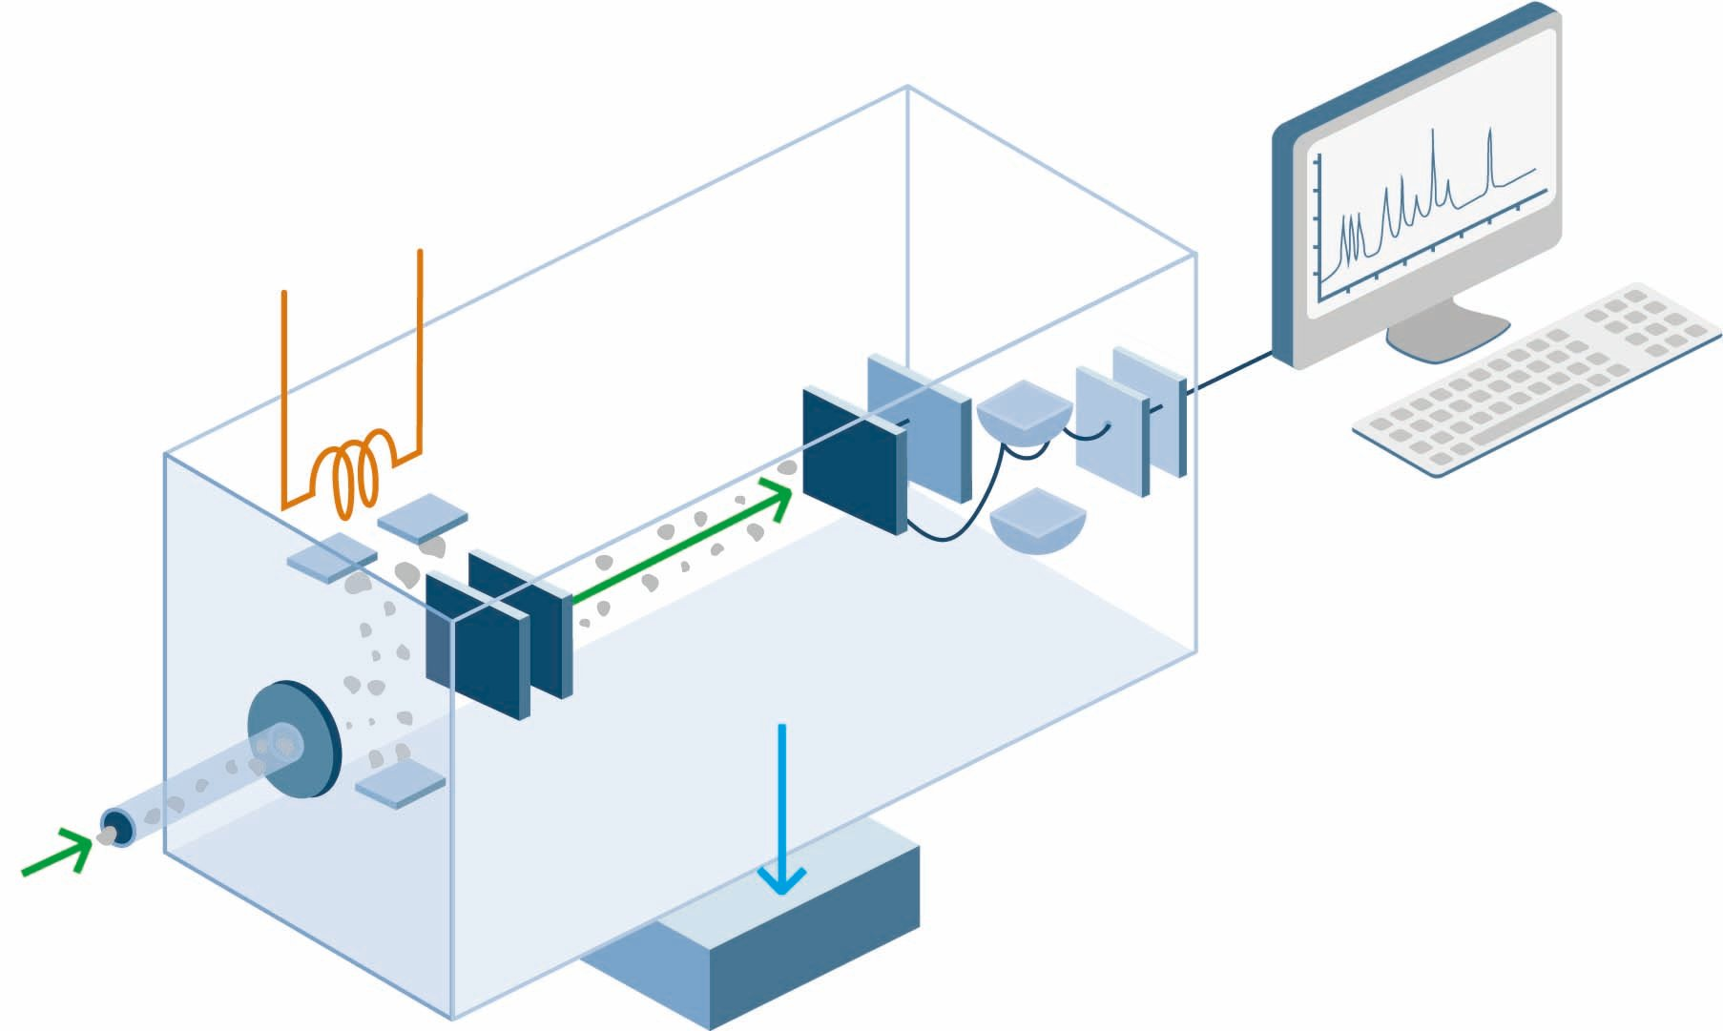
Mass Spectrometer
A mass spectrometer is used to understand the composition of a sample.

Slide 2
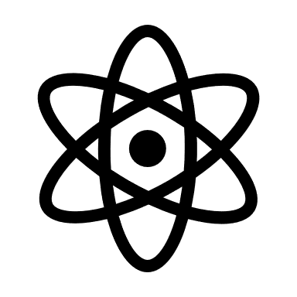
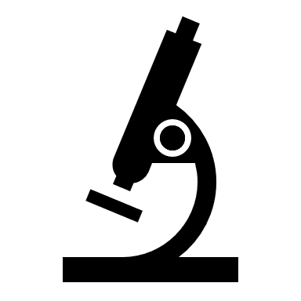
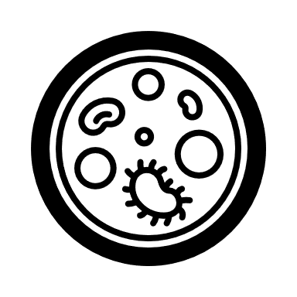

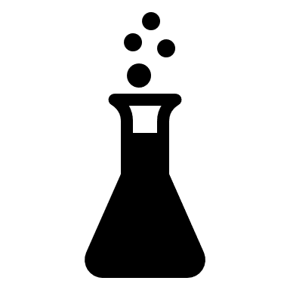
A mass spectrometer essential breaks down a substance to determine what it is made of. The mass spectrometer produces ions (charged particles) and uses an electric and/or magnetic fields to sort the ions based on their mass (or weight) and charge. The separated ions are measured and displayed on a graph. This provides information about the relative abundance of different ions as well as their mass and charge.
Mass spectrometry is commonly used in laboratories to study physical, chemical, or biological properties of a great variety of compounds.
One mission, the Europa Clipper, hopes to use mass spectrometry to investigate the chemistry of Europa’s surface, atmosphere, and suspected ocean. The Europan Molecular Indicators of Life Investigation proposes to use mass spectrometry to search for extraterrestrial life!

Slide 3
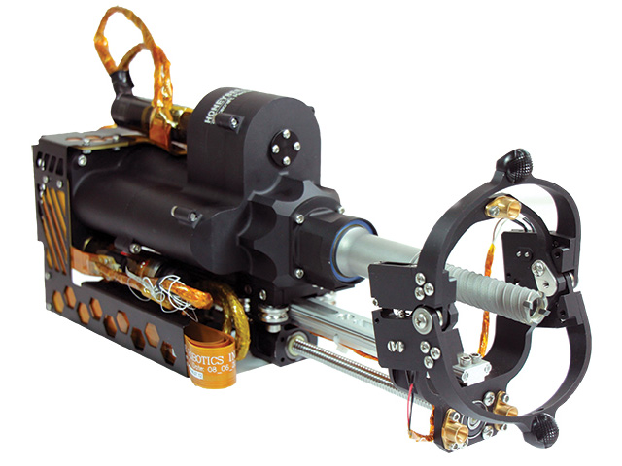
Drill
Many samples of rock and ice are collected by drilling.

Slide 4
There are many different types of drills that can be used to collect samples. Choosing the right drill is important to successful sampling!
The Mars Perseverance rover uses a rotary-percussive drill and a tube-like drill bit to keep the rocky sample snug.
Drilling ice samples on Europa will be different. Melt probes use a hot tip to melt through ice and penetrate downward. Electro-mechanical drills can shave the ice as they drill. It is possible that a combination these types of drills will used on icy worlds.
Drill can be hard! The first rock sample that Perseverance attempted to collect crumbled before it could be collected.
Notes:
Using a hollow, tube-like drill bit that traps rocky material inside, Perseverance drilled a hole a few inches deep using a rotary-percussive drill installed at the end of its seven-foot sampling arm. A twisting mechanism inside the drill bit snapped the rock core off of Rochette and kept it snug inside a sample tu

Slide 5
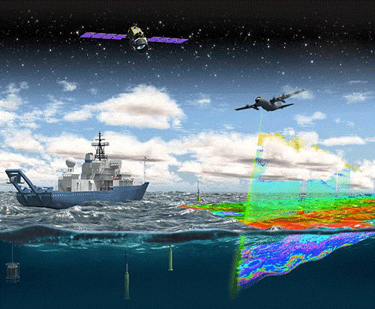
LIDAR
Lidar stands for Light Detection and Ranging. Lidars are used for remote sensing: gathering information without touching something!
Notes:
Lidar comes in three major varieties: range finders, dial (Differential Absorption Lidar) and Doppler lidar. Range finders, like radar, emit a pulse of light and measure the time interval between when the pulse is emitted and when the reflected pulse is detected. Like radar, they are used to determine the distance to an object. Because of its much shorter wavelength, laser range finders are effective for much smaller targets. Indeed, by scanning the surface of the target, advanced range finders can determine the target's shape and size in addition to its distance. Dial lidar can be used to measure the temperature, density, and pressure of trace gases and aerosols in the atmosphere. Two probe laser beams are used, one with a wavelength that corresponds to a target gas absorption peak (on-line) and the other that falls between the target gas's absorption features (off-line). The ratio of the on-line to off-line returned signal strength is related to the absorption characteristics (which in turn depend on the temperature, density, and pressure) of the target gas.

Slide 6
Lidar (light detecting and ranging) is used to probe an environment around you without touching it. Some examples of passive lidar include your eyes and telescopes!
Lidar used to actively investigate space send out light rays which bounce off objects and return to a sensor. The changes in the light properties (such as angle and intensity) provide information about the target.
There are many types of lidar. The three main varieties are range finders (distance), differential absorption lidar (temperature, density and pressure gases in an atmosphere) and doppler (velocity).
Lidar can be used for many applications. For example , the Clementine missin to the moon in 1994 used LIDAR data to track its orbit around the moon as well as create models that revealed the shape and internal structure of the moon.
Notes:
Lidar comes in three major varieties: range finders, dial (Differential Absorption Lidar) and Doppler lidar. Range finders, like radar, emit a pulse of light and measure the time interval between when the pulse is emitted and when the reflected pulse is detected. Like radar, they are used to determine the distance to an object. Because of its much shorter wavelength, laser range finders are effective for much smaller targets. Indeed, by scanning the surface of the target, advanced range finders can determine the target's shape and size in addition to its distance. Dial lidar can be used to measure the temperature, density, and pressure of trace gases and aerosols in the atmosphere. Two probe laser beams are used, one with a wavelength that corresponds to a target gas absorption peak (on-line) and the other that falls between the target gas's absorption features (off-line). The ratio of the on-line to off-line returned signal strength is related to the absorption characteristics (which in turn depend on the temperature, density, and pressure) of the target gas.
CLemetine's orbit around the moon as well as to create models that revealed the shape and internal structure of the moon.

